Slide 1
LinkedIn Posts Search

Slide 2
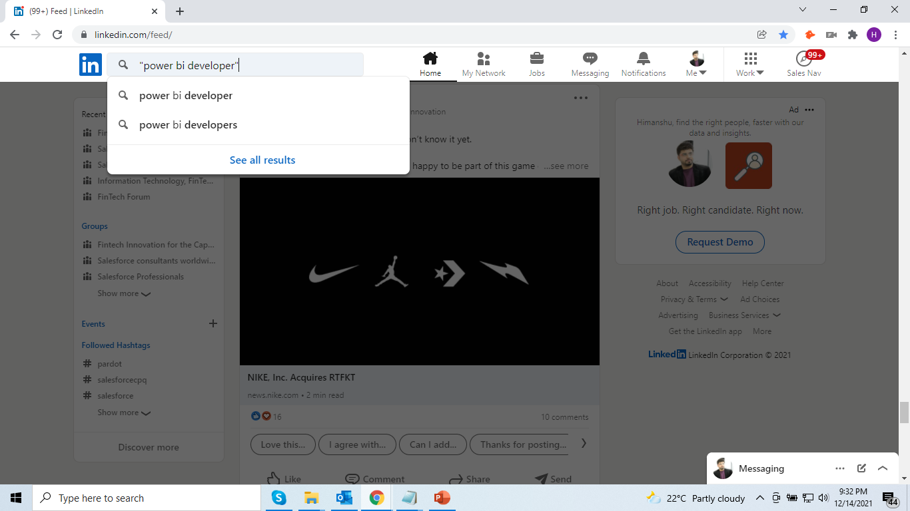

Slide 3
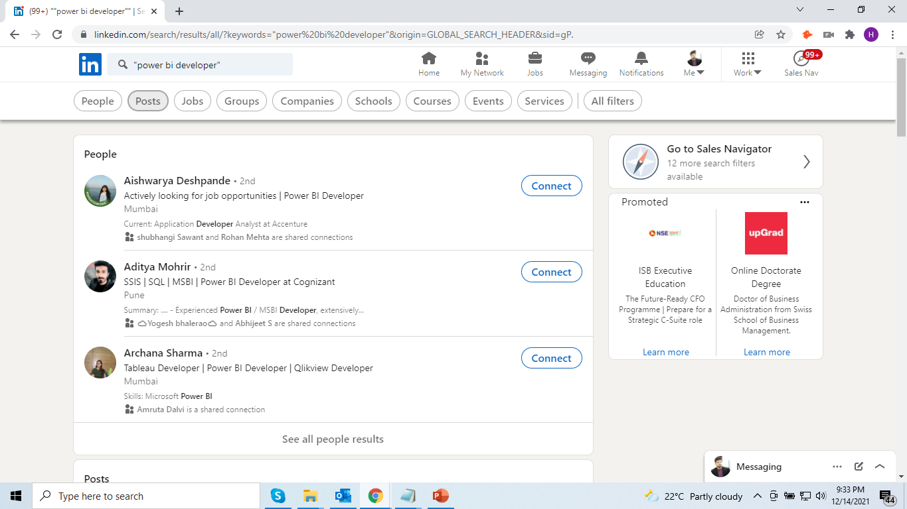

Slide 4
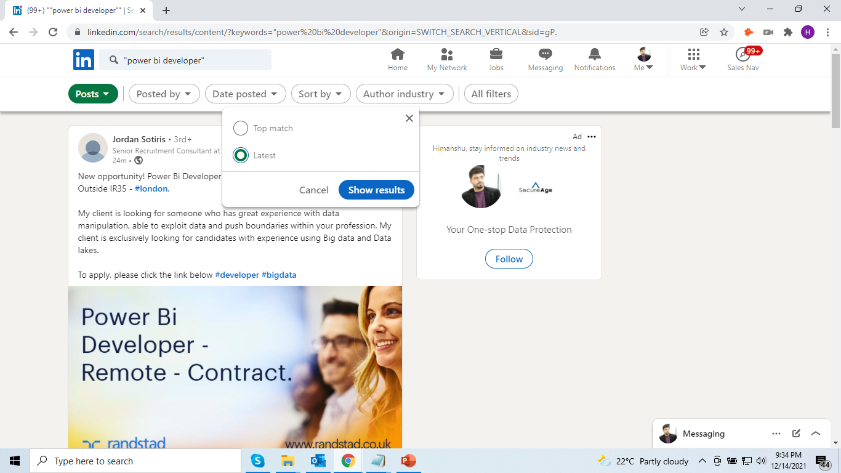

Slide 5
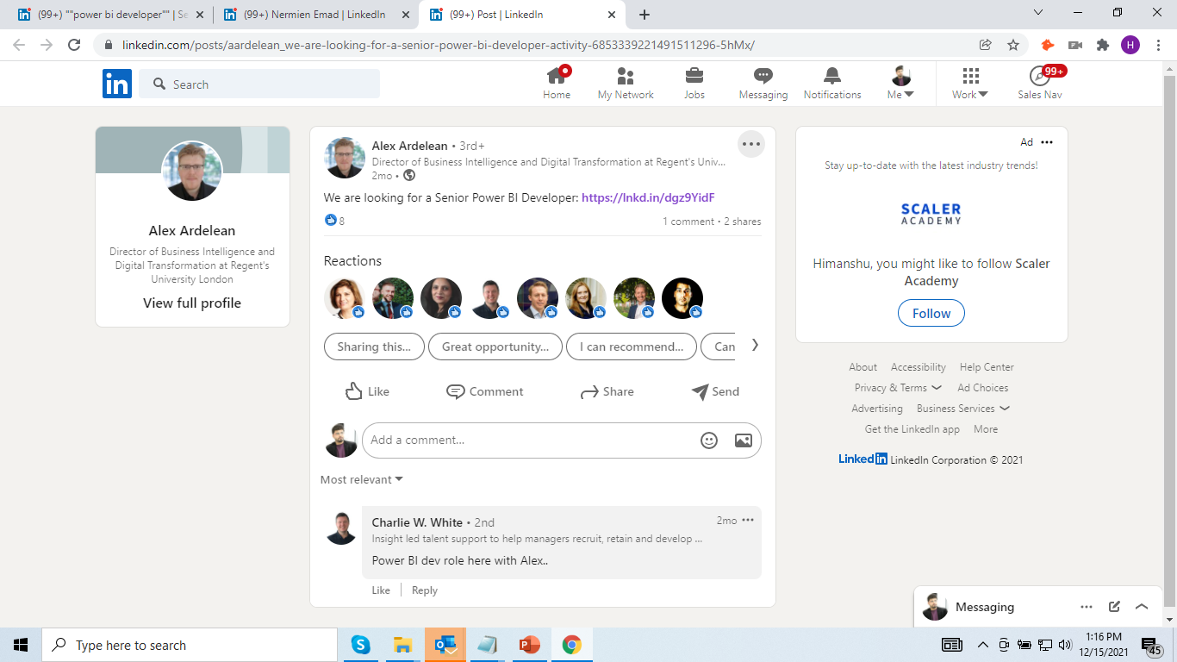
Notes:
https://www.linkedin.com/posts/aardelean_we-are-looking-for-a-senior-power-bi-developer-activity-6853339221491511296-5hMx

Slide 6
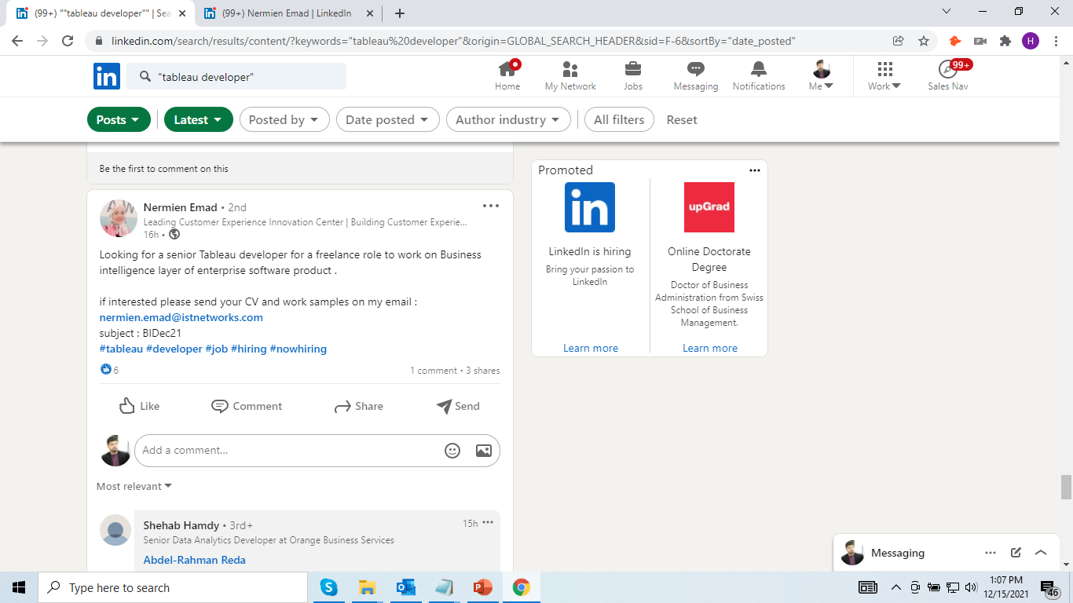
Notes:
https://www.linkedin.com/feed/update/urn:li:activity:6876532242215182336/

